Slide 1
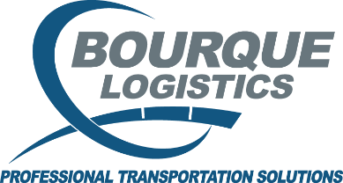
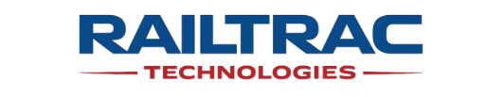
TRANSPay® Invoice Payment Services
Reduce invoice volume, eliminate errors, and pay vendors on time – without increasing headcount
TiPS™
©2026 RAILTRAC Technologies – All Rights Reserved

Slide 2
TRANSPAY® INVOICE PAYMENT SERVICES – TiPS™
The Real Problem
Why Rail Payables Breaks at Scale:
Hundreds of invoices across railroads, shops, lessors, tax authorities
No single system of record across freight, repair, lease, assessorial
Manual validation, coding and approvals
01
02
03
Constant vendor inquiries and disputes
Limited visibility into total rail spend
Reconciliation headaches
04
05
06
“Rail AP isn’t just high volume – it’s operationally complex”
©2026 RAILTRAC Technologies – All Rights Reserved
02

Slide 3
TRANSPAY® INVOICE PAYMENT SERVICES – TiPS™
The Solution
Take control of complex, high volume transportation payables – without adding headcount
TiPS™ A Controlled, End-to-End Payment Process:
“You don’t process rail invoices – you control rail spend”
Consolidate 100s of invoices into 1-4 clean funding requests
Automated audit and validation before payment
All invoice types handled (freight, repair, lease, tax, assessorial)
Exceptions and disputes fully managed
Guarantee on-time payments with full remittance transparency
Seamlessly integrate with your ERP (SAP, Oracle, MS, etc.)
Payments in international currencies
Supported by payor and supplier portals that eliminate inbound noise
©2026 RAILTRAC Technologies – All Rights Reserved
03

Slide 4
TRANSPAY® INVOICE PAYMENT SERVICES – TiPS™
Controls & Security
Enterprise-Grade Controls Built for High – Value Rail Spend:
“Every dollar is validated, approved and traceable”
Segregation of duties + dual approvals
Independent systems for rates, audit and payments
No comingling of funds (dedicated accounts)
Full audit trail on every transaction
SOC 1 (Financial) & SOC 2 Type II (Security) compliant
Independent reconciliation and oversight
©2026 RAILTRAC Technologies – All Rights Reserved
04

Slide 5
TiPS™ Outcome
What This Delivers for Rail Logistics & Finance:
01
02
03
Cost Control
Operational Alignment
Visibility & Control
Reduced invoice volume and manual workload
Fewer errors, disputes and overpayments
Faster reconciliation and financial close
One process across all rail-related spend
Fewer vendors, fewer handoffs
Real-time dashboards and remittance detail
Full approval before any payment is released
What Leading Shippers Are Doing Today:
Consolidated payment platforms
Automated invoice audit + validation
Centralized control of rail spend
Integrated operations + finance workflows
“Fewer invoices. Fewer errors. Full control of rail spend”
©2026 RAILTRAC Technologies – All Rights Reserved
05

Slide 6
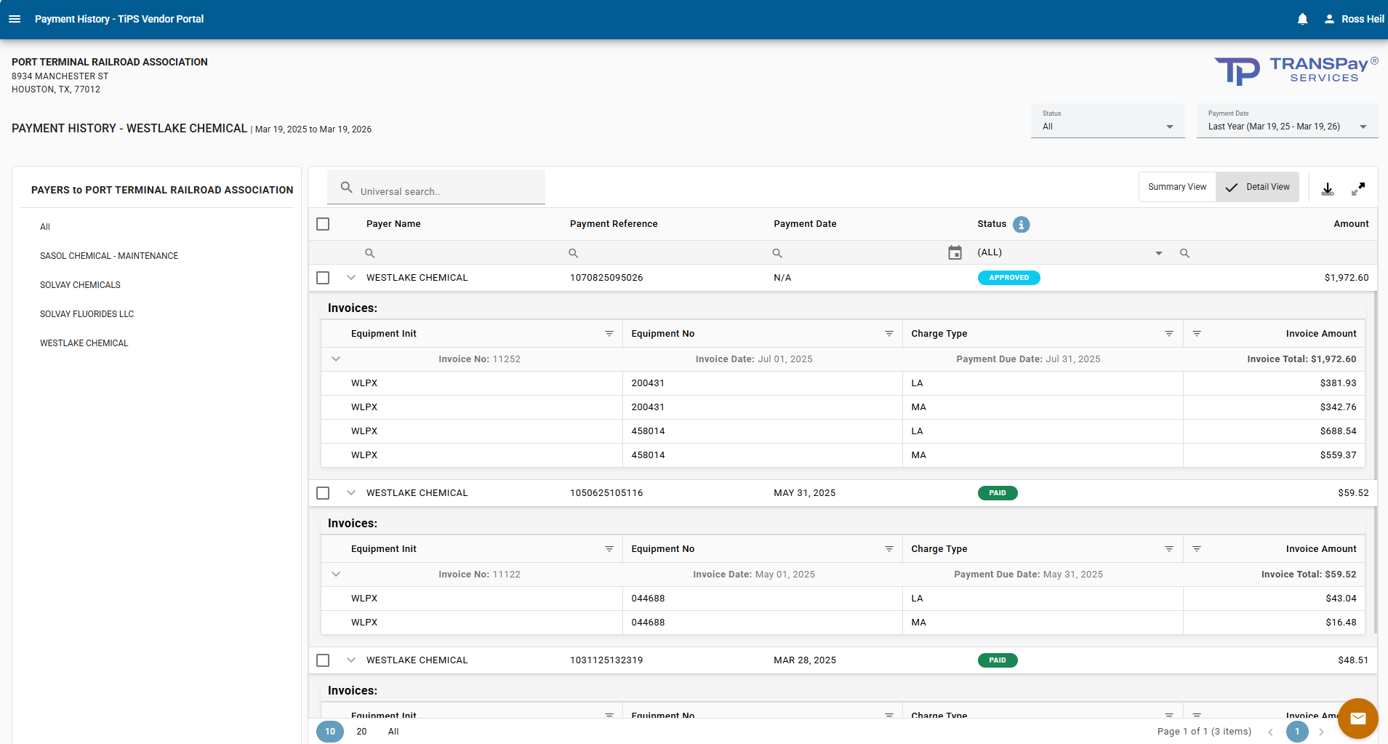
TRANSPAY® INVOICE PAYMENT SERVICES – TiPS™
Visibility, Reporting & Strategic Value
Supplier Portal - Fewer Emails, Calls, & Escalations
Vendor Management:
No set up, no management of vendors in ERP
On time and accurate payment keeps vendors happy
Faster issue resolution
Self-serve vendor portal provides invoice status and remittance advice
Possible future discount opportunities for early payment
©2026 RAILTRAC Technologies – All Rights Reserved
06

